Slide 1
EXPERIMENTAL ANALYSIS OF FLAPPING FLIGHT MECHANISM OF BIRDS
Project Members:
1. Pranav Chauhan (1309140068)
2. Rishabh Gupta (1309140082)
3. Shiv Mani Yadav (1309140096)
4. Siddharth Singh (1309140105)
Project supervisor :
Dr. Prashant Chauhan
(Associate Professor)

Slide 2
OBJECTIVE
TO EXPERIMENTALLY ANALYSE THE FLAPPING FLIGHT MECHANISM OF BIRDS
VARIOUS STEPS TAKEN TO FULL FILL THE OBJECTIVE
TO CONDUCT THE EXPERIMENT, FIRSTLY A LOW SPEED WIND TUNNEL WAS FABRICATED
TO VERIFY THAT THE WIND TUNNEL HAD DESIRABLE CHARACTERISITCS, A SMOKE VISUALISATION TEST WAS PERFORMED
LATER SMOKE VISUALISATION OF AEROFOIL TEST WAS PERFORMED AND A BIRD WAS MADE TO FLY IN THE TUNNEL FOR THE FLAPPING FLIGHT ANALYSIS
USING IMAGE AND VIDEO PROCESSING, THE FLAPPING FLIGHT WAS ANALYSED AND DEDUCTIONS WERE MADE

Slide 3
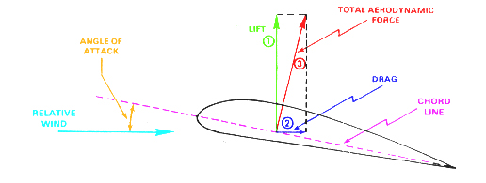
Fixed wing flight

Slide 4
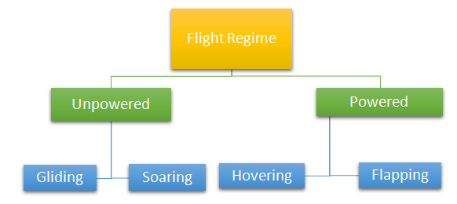
Classification of flight regime

Slide 5
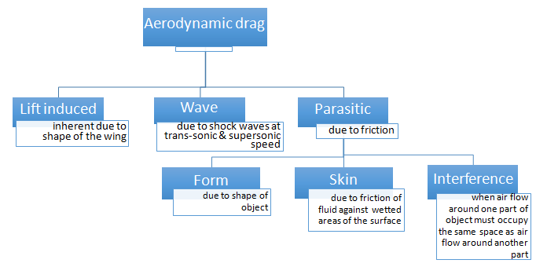
Drag

Slide 6
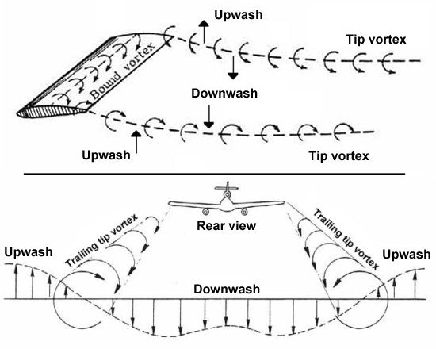
Wake Turbulence

Slide 7
DESIGNING OF WIND TUNNEL
The wind tunnel consists of following sections and features
Contraction cone
Diffuser cone
Test section
Honeycomb mesh

Slide 8
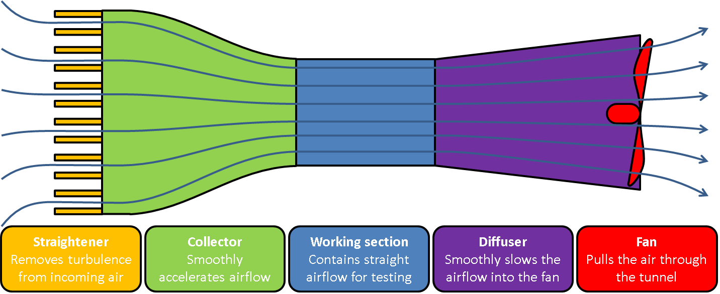
Wind Tunnel sections

Slide 9
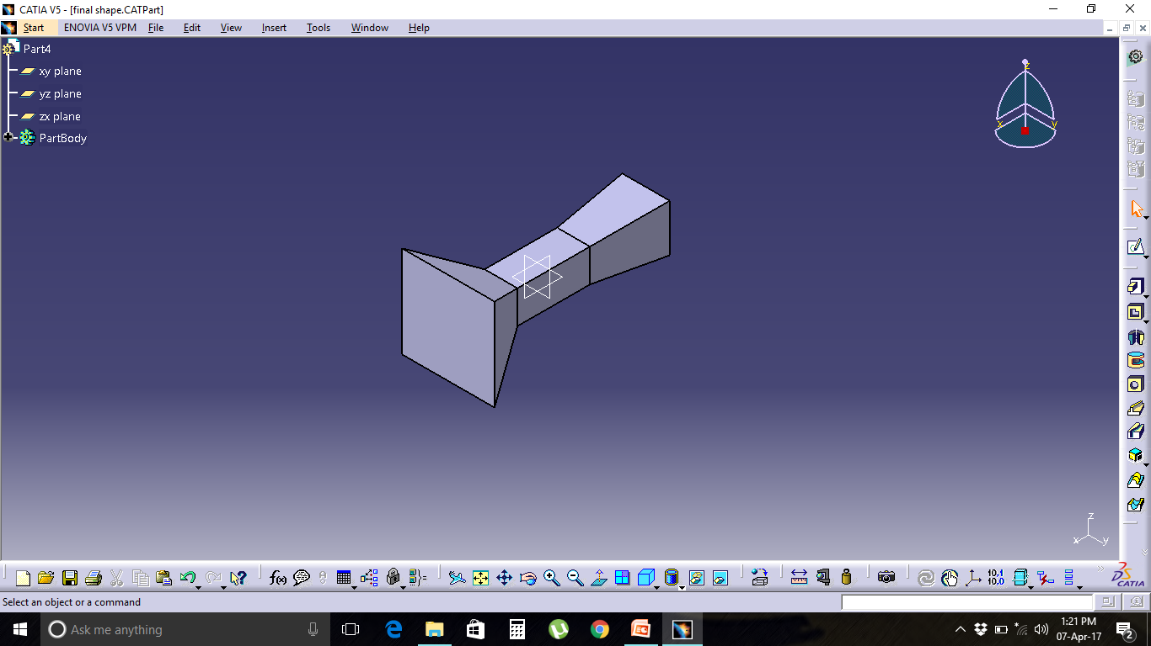
CATIA MODEL

Slide 10
CONTRACTION CONE
The contraction accelerates the flow to the test section, further reducing an variations in velocity. The contraction starts with the selection of contraction ratio 6. For smaller tunnels the contraction ratio should be in between 6 to 9. The length of the contraction should be in between 0.15 R to R. R being the hydraulic radius of the contraction section inlet. Too large contraction section avoids flow separation.For easier and cheaper construction a straight contraction shape is used instead of solving complex equations to get the wall shape. The nozzle exit cross section dimensions and shape are identical to the test chamber

Slide 11
DIFFUSOR CONE
The diffuser is mainly used to reduce the velocity of flow in the shortest possible distance to reduce the load on drive system. The flow through the diffuser depends on its geometry defined by area ratio (ratio of outlet area to the inlet area) and diffuser angle (2θ), wall contour and diffuser cross-sectional shapes. The area ratio of the diffuser should be less than 2.5 and diffuser angle should be 5˚ – 7˚ for controlling flow separation. The minimum length of diffuser can be found from Equation,
Where, Dh1 is the inlet sections hydraulic diameter

Slide 12
TEST SECTION
Test Section The first step in wind tunnel design is defining a priori the test chamber criteria which are dimensions, shape and desired air velocity. The test chamber length has to be in the range of 0.5 - 3 times its hydraulic diameter. This choice takes into account that the air flow exiting the nozzle needs 0.5 times the hydraulic diameter to become almost uniform. Moreover, a long test chamber (more than 3 times the equivalent hydraulic diameter) could increase boundary layer thickness causing the boundary layer to detach at the test chamber exit. The test chamber also has flanges and windows to allow sample observations and introduce measuring tools.

Slide 13
HONEYCOMB MESH
The honeycomb removes the swirl from the incoming flow and minimizes the variation in both mean and fluctuating velocity. It should have sufficient flexural rigidity to withstand applied forces during operation without significant deformation. The primary design parameter for honeycomb is the ratio of length to cell hydraulic diameter (L/D) and porosity (flow area upon total area). Recommended L/D ratio for honeycomb is 6 to 8 with porosity nearly 0.8

Slide 14
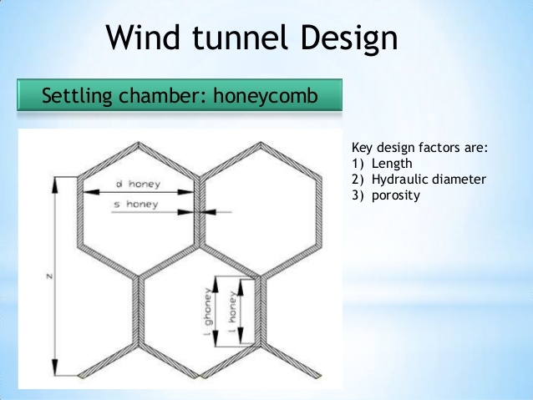

Slide 15
DESIGN PROCESS
Phase 1: Design to meet the length requirement .
Phase 2: Design for the required (and available) fan considering the constraints with the assumption of ideal flow.
Phase 3: Design based on flow quality constraints with the assumption of viscous flow.

Slide 16
Phase 1
Cone angle =5.36 degrees
Area ratio between diffuser nozzle and test section area=2.07
Area ratio between contraction nozzle and test section area= 7-11
Phase 2
Velocity required in the test section= 0-5m/s
Velocity in the contraction section= 𝑈4 = 𝑈3*𝐴3/𝐴4
Velocity in the diffuser section =𝑈2 = 𝑈3*𝐴3/𝐴4

Slide 17
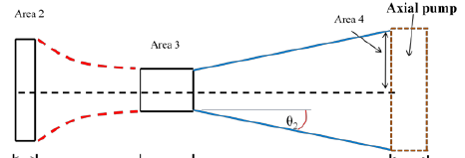
Configuration of wind tunnel

Slide 18
Contraction cone design
Constraints
For smaller tunnels the contraction ratio should be in between 6 to 9.
The length of the contraction should be in between 0.15 R to R
Assumed edge length of the inlet of contraction cone 3.5 ft
hydraulic radius =(1.75^2+ 1.75^2)^0.5=2.47
Range of length of contraction cone 0.37 to 2.47 ft
length of contraction cone taken =1.5 ft

Slide 19
Diffusor cone design
Constraints
The area ratio of the diffuser should be less than 2.5
diffuser angle should be 5˚ – 7˚
Assumed edge length of the inlet of diffusor cone 1.8 ft
hydraulic radius =(0.9^2+ 0.9^2)^0.5=1.27=Dh1
Area ratio =A4/A3=(1.8*1.8)/(1.25*1.25)= 2.0736=AR
length of diffusor cone calculated by formula
tan2θ=(1.8-1.25)/L
length of contraction cone taken =2.75 ft
θ=5.65

Slide 20
Test section design
Constraints
The test chamber length has to be in the range of 0.5 - 3 times its hydraulic diameter
Assumed edge length of the test section 1.25 ft
hydraulic radius =(0.625^2+ 0.625^2)^0.5=0.88
Range of length of contraction cone 0.44 to 2.64 ft
length of test section taken =2.5 ft

Slide 21
Honey comb mesh design
Constraints
the ratio of length to cell hydraulic diameter (L/D) should be between 6 to 8
The diameter of the honey comb mesh available in the market is 0.6mm
So the length of the mesh was taken as 3.6mm in order to make the ratiov as 6

Slide 22
Contraction ratio
Constraint
For smaller tunnels the contraction ratio should be in between 6 to 9
Contraction ratio =A2/A3
=(3.5*3.5)/(1.25*1.25)=7.84
Which lies between 6 to 9

Slide 23
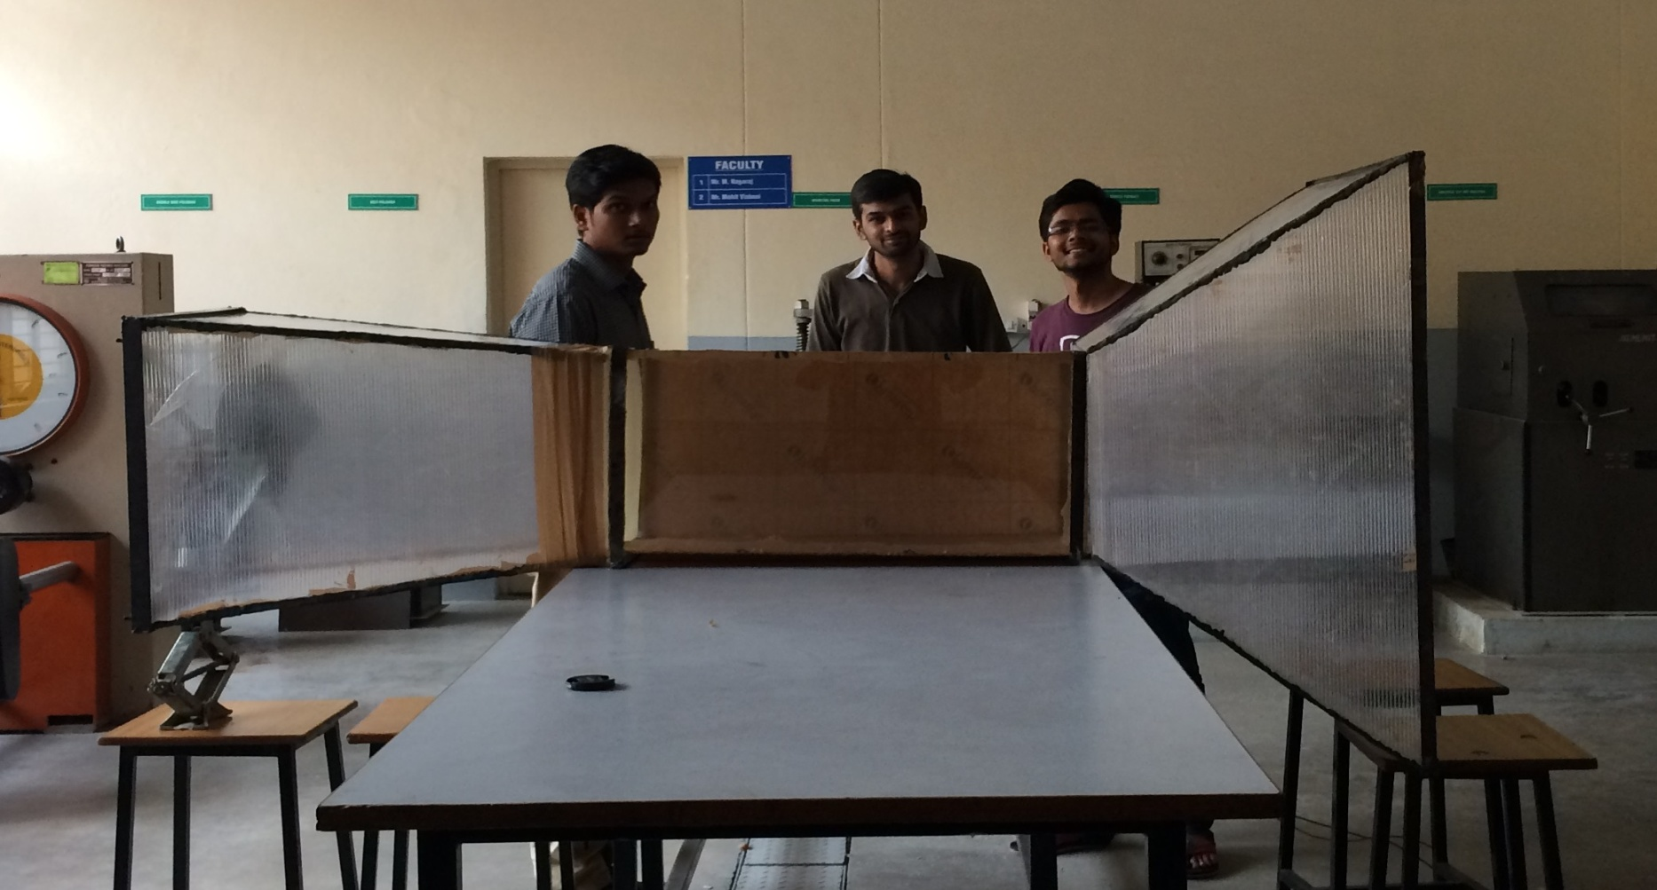
OUR DESIGNED WIND TUNNEL

Slide 24
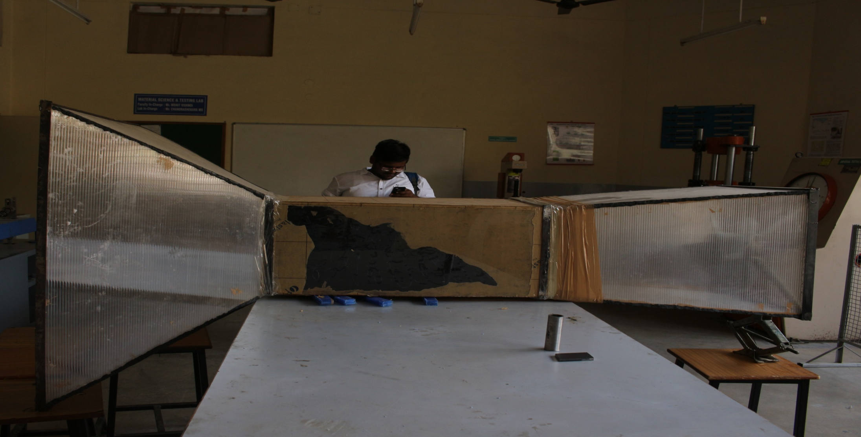

Slide 25
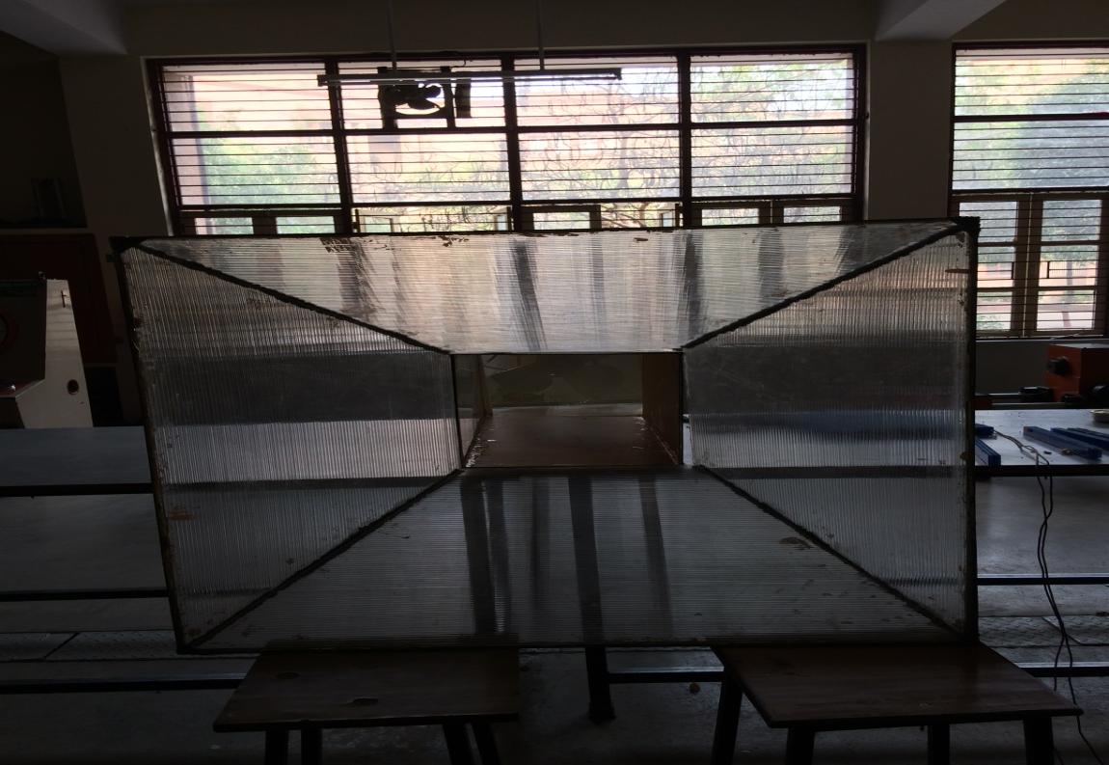
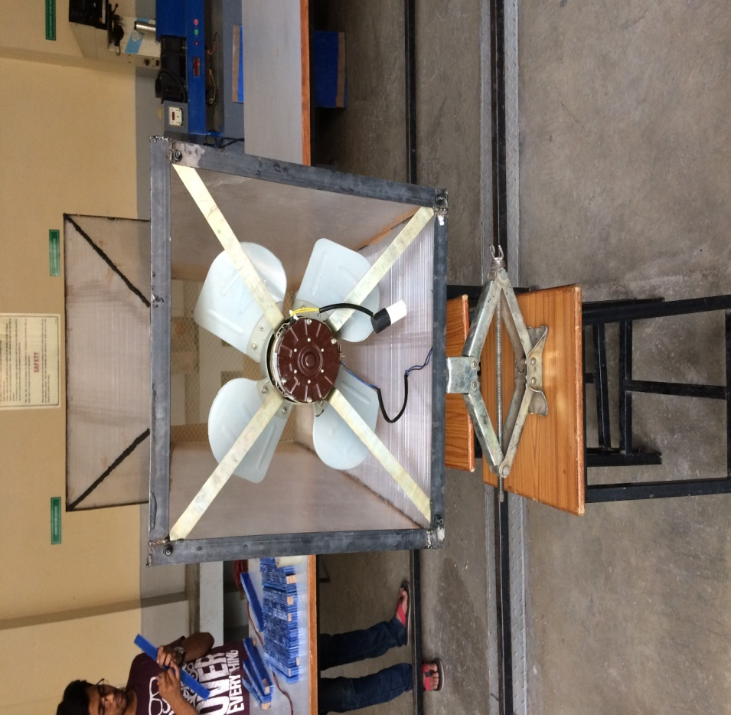

Slide 26
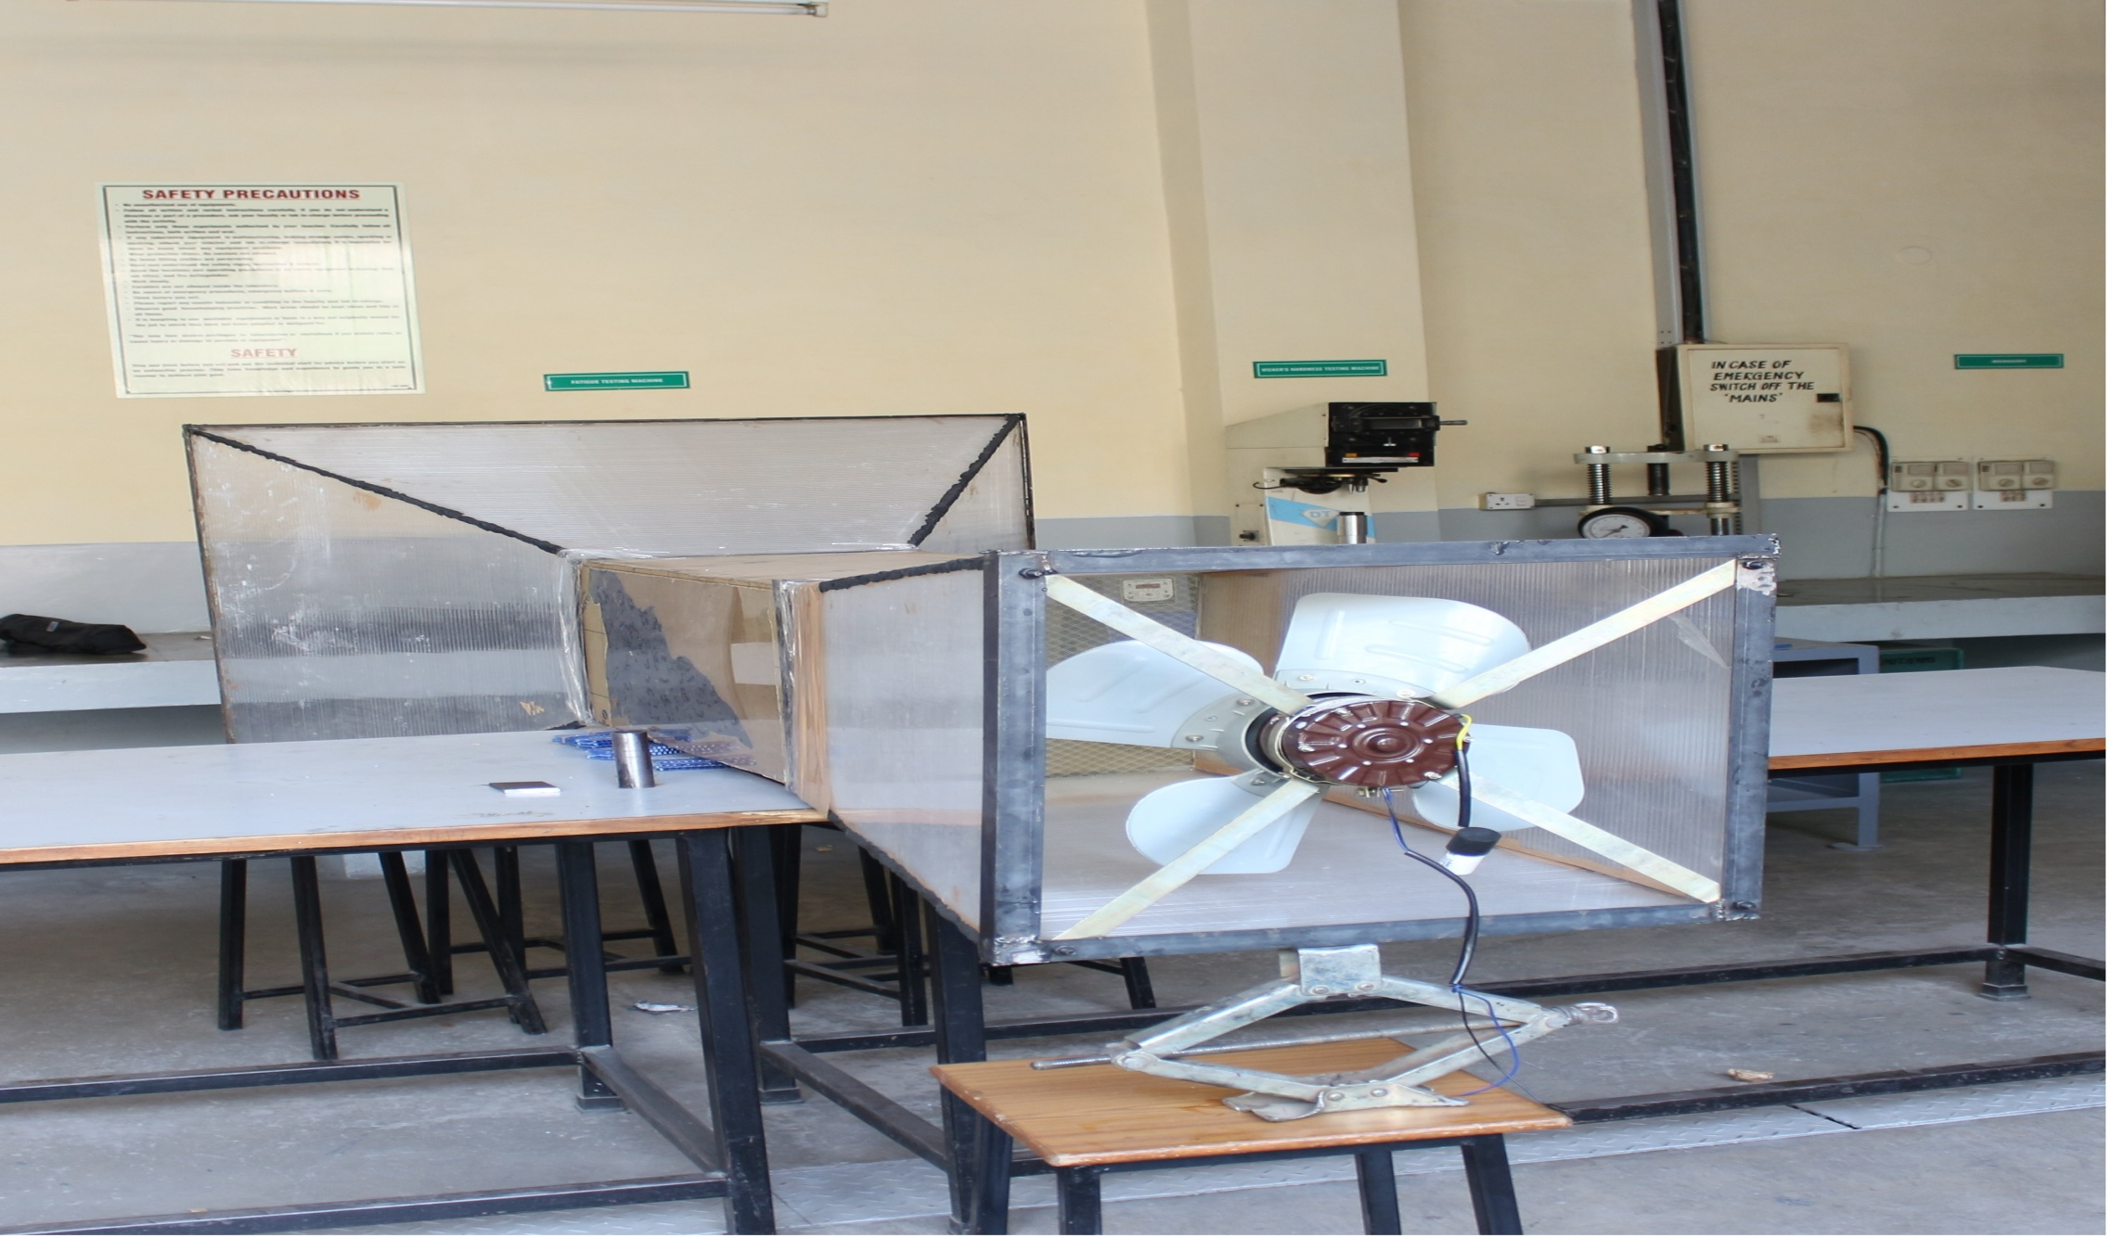

Slide 27
Experiments And Studies
Smoke visualization study
Bird wing aerofoil and bird flight study
Bird flight analysis

Slide 28
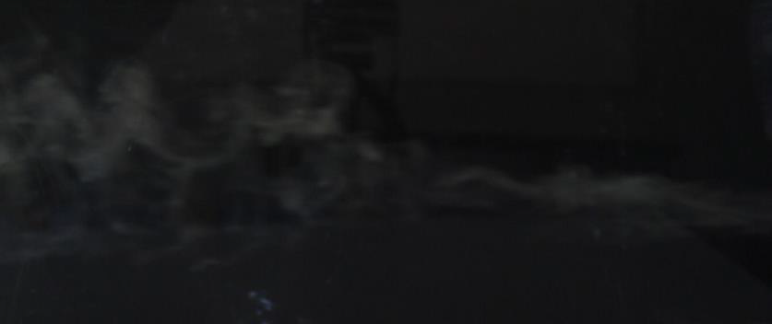
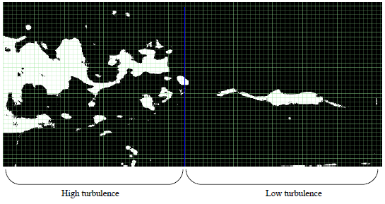
Smoke Visualization Study Rotor speed: 445.4rpm | Wind speed: 2.33m/s | Image processing threshold value: 30
Characteristics: highly turbulent

Slide 29
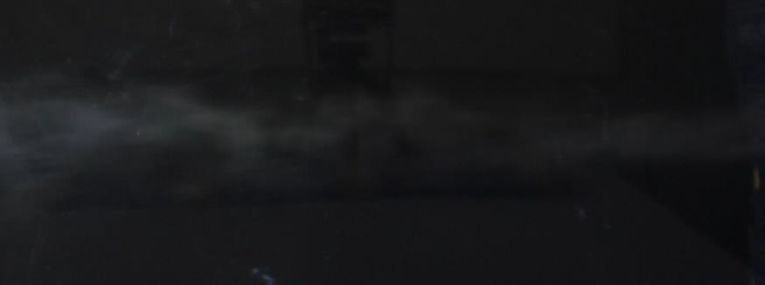
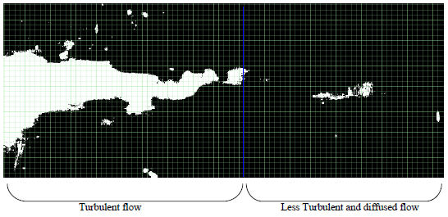
Rotor Speed: 556.6 rpm| Wind Speed 3.55 m/s | Image processing Threshold: 30 |
Characteristics: Turbulent and diffused

Slide 30
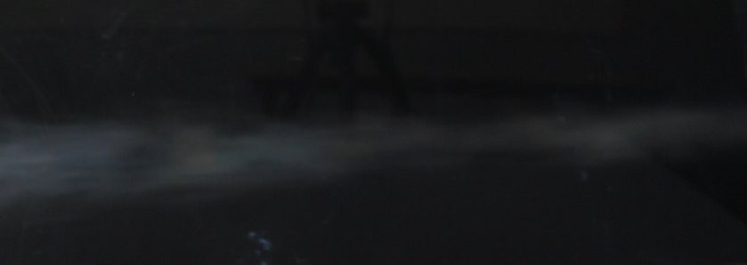
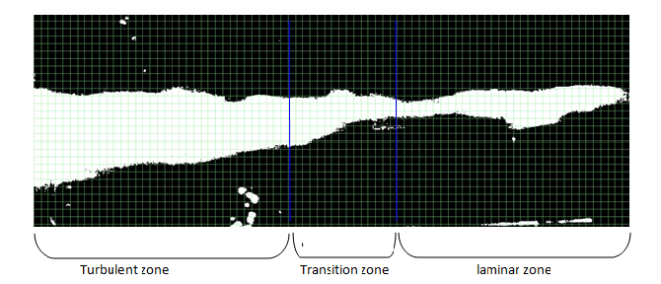
Rotor Speed: 672.9 | Wind speed: 4.27: Image processing threshold value: 25

Slide 31
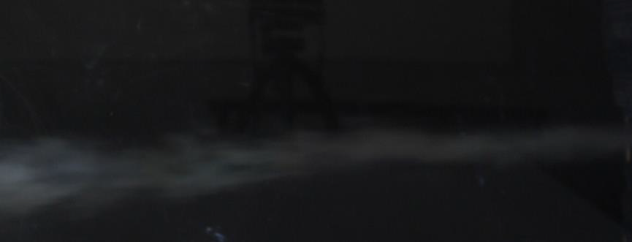
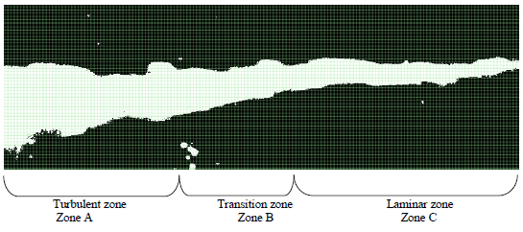
Rotor Speed: 780.3rpm | Wind speed: 4.82m/s : Image processing threshold value: 25

Slide 32
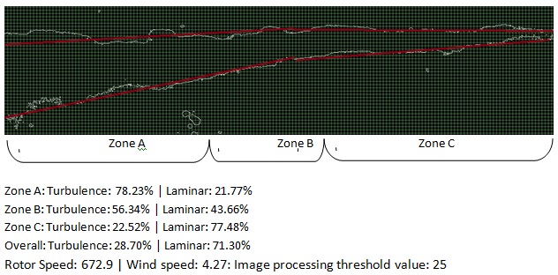

Slide 33
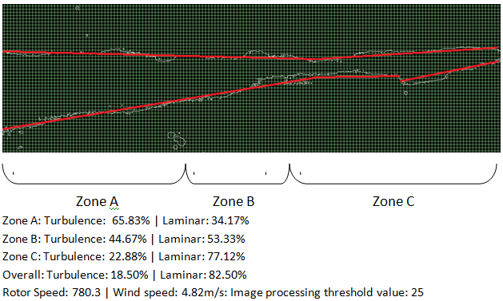

Slide 34
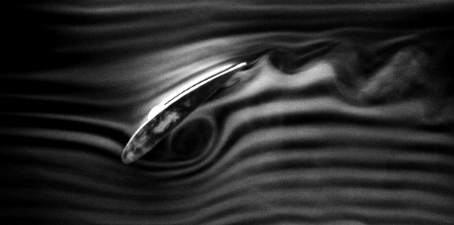

Bird Wing Aerofoil And Bird Flight Study
Study In Two Positions Of The Bird Flight
Flight
Stall
Velocity: 4.9m/s | Image processing threshold value: 30
Flow around aerofoil 1
Processed image airfoil 1

Slide 35


Flow around airfoil 2
Processed image airfoil 2

Slide 36
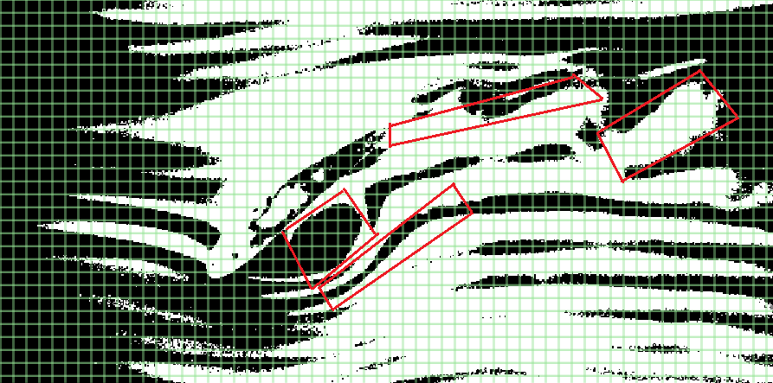
Processed image airfoil 3

Slide 37
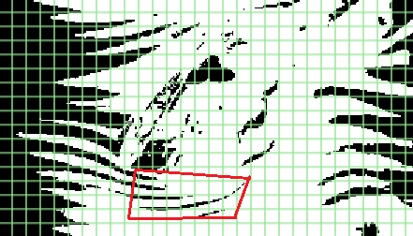
Processed image airfoil 4

Slide 38
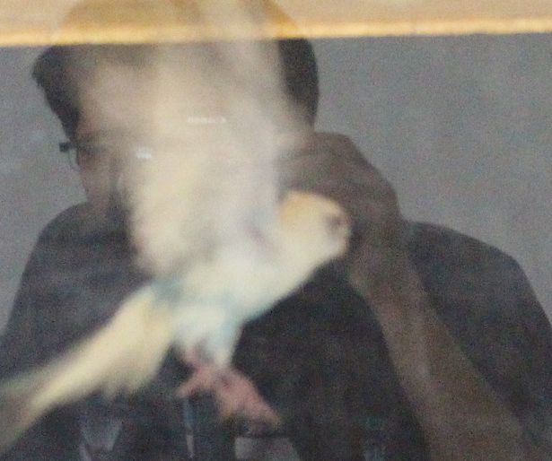

Bird Flight Analysis Wind speed: 4.9m/s Rotor speed: 795RPM Shutter speed of camera: 50frames per second Image processing threshold : 24
Bird flight analysis 1

Slide 39
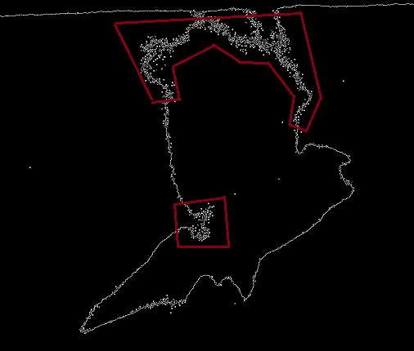
Upstroke
Processed image- upstoke

Slide 40
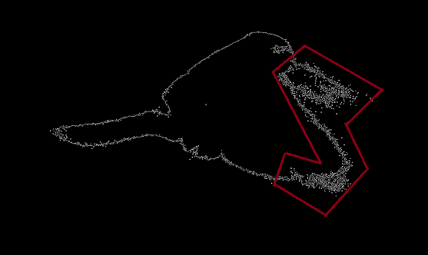
Downstroke
Processed image- downstroke

Slide 41
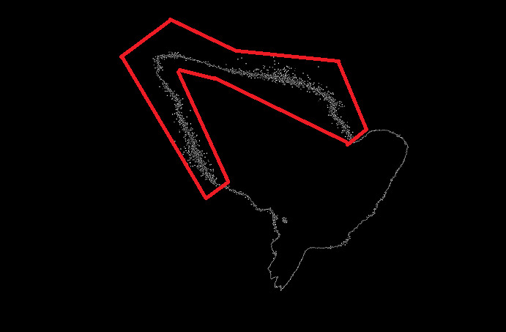
Stalling Flight
Processed image-stalling

Slide 42
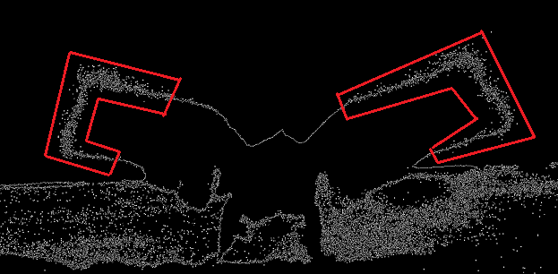
Take Off
Processed image- stalling

Slide 43
CONCLUSION AND RESULTS
RESULTS FROM SMOKE VISUALISATION.
For increase in speed, the flow became increasingly laminar with some amount of turbulence depicted in the study.
The laminar nature of the flow is maximum at the end of the contraction cone and minimum at the beginning of the diffuser section.
Through the various wind speeds, different levels of laminar and turbulent natures are achieved,
The laminar and turbulent nature is variable in different zones of the test section ranging from laminar flow to turbulent flow and transition zone.

Slide 44
RESULTS FROM SMOKE VISUALIZATION STUDY OF AEROFOIL
In the flight motion, with angle of attack lying in the range of 0 to 45 degrees, vortexes are created underneath the foil to create a high pressure region to create a lift force.
At the trailing edge, wing tip vortexes are created creating some amount of drag force.
In the stall motion, with angle of attack more than 45 degrees, the smoke gets diffused underneath the aerofoil and high pressure regions are created above the aerofoil. Wing tip vortices are also created in this situation also.
BIRD FLIGHT ANALYSIS
Bird flight analysis is done to realize the various parts of the bird’s wings which are high motion during the various phases of the flight mechanism.
During the take-off motion, the majority of the wing tip and extended portions of the wing tip to some extent are under motion in the first step which further leads to motion of the entire wing.
During the stall mode, the wing tips are extended backwards and the motion of the all the edges of the wing is less.
During the up-stroke and down-stroke the various parts of the wings are under high motion and vibrations.

Slide 45
POSSIBLE IMPLICATIONS AND APPLICATIONS
By studying the various vibratory motions and portions of the wing tips which are under motion during the various flight modes, we can optimize the transient vibratory phases and improve the efficiency of flapping flight.
The various modes of the flights can also be optimized and improved upon to create a better flapping mechanism.

Slide 46
Thank you…

